Slide 1

CSA 1481-COMPILER DESIGN FOR CODE OPTIMIZATION
GUIDED BY
DR.SANKAR
Presented by
Satya, Jeevan, Bhargava

Slide 2

OPTIMIAZTION TECHNIQUES IN COMPILER DESIGN

Slide 3


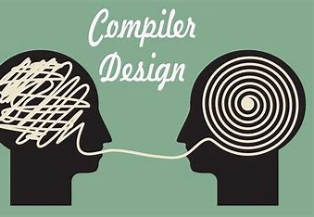



1.ABSTRACT & PROBLEM STATEMENT
OVERVIEW
2.INTRODUCTION
3.FLOWCHART
4.CODE & RESULTS
5.DISCUSSION & CONCLUSION
6.FUTURE SCOPE

Slide 4

Summary of the Project Goals and Achievements:
Compiler optimization techniques are crucial for enhancing the performance and efficiency of compiled programs.
By implementing and evaluating different optimization techniques, this project aims to provide insights into their effectiveness and trade-offs, ultimately contributing to the development of more efficient compilers.
ABSTRACT
Main Objectives of the Project:
To study and understand various optimization techniques used in compiler design, including loop optimization, data flow analysis, inline expansion, and instruction scheduling.
To implement selected optimization techniques in a compiler or compiler framework and evaluate their impact on code performance.
OBJECTIVE

Slide 5


PROBLEM STATEMENT:
This project focuses on improving the performance of programs by applying optimization techniques in compiler design.
Compilers transform the code written by developers into machine code that computers can execute. However, the initial machine code generated by compilers is often not the most efficient.
We will measure how much faster the optimized code runs compared to the original code.

Slide 6

Feautures:
Executes faster.
Code size get reduced.
Efficient memory usage.
Yielding better performance.
Reduces the time and space complexity.
OPTIMIZATION:
In computing , optimization is the process of modifying a System to make some aspect of it work more efficiently or use fewer resources.
In optimization , high level general programming constructs are replaced by very efficient low level programming codes.
PROBLEM STATEMENT:
CODE OPTIMIZATION

Slide 7

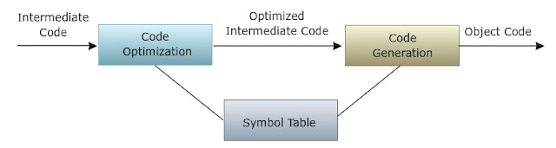
INTRODUCTION:
CODE OPTIMIZATION CATEGORIES :
Machine Independent optimizations:
Improve target code taking properties of target machine into considerartion.
Machine Dependent optimization:
Improve target code by checking properties of target machine.
CODE OPTIMIZATION OCCURS SEVERAL LEVELS:
COMPILE LEVEL
Use of an optimizing compiler tends to ensure that the executable program is optimized at least as much as the compiler can predict.
DESIGN LEVEL
At the highest level, the deisgn may be optimized to make best use of the available resources.

Slide 8

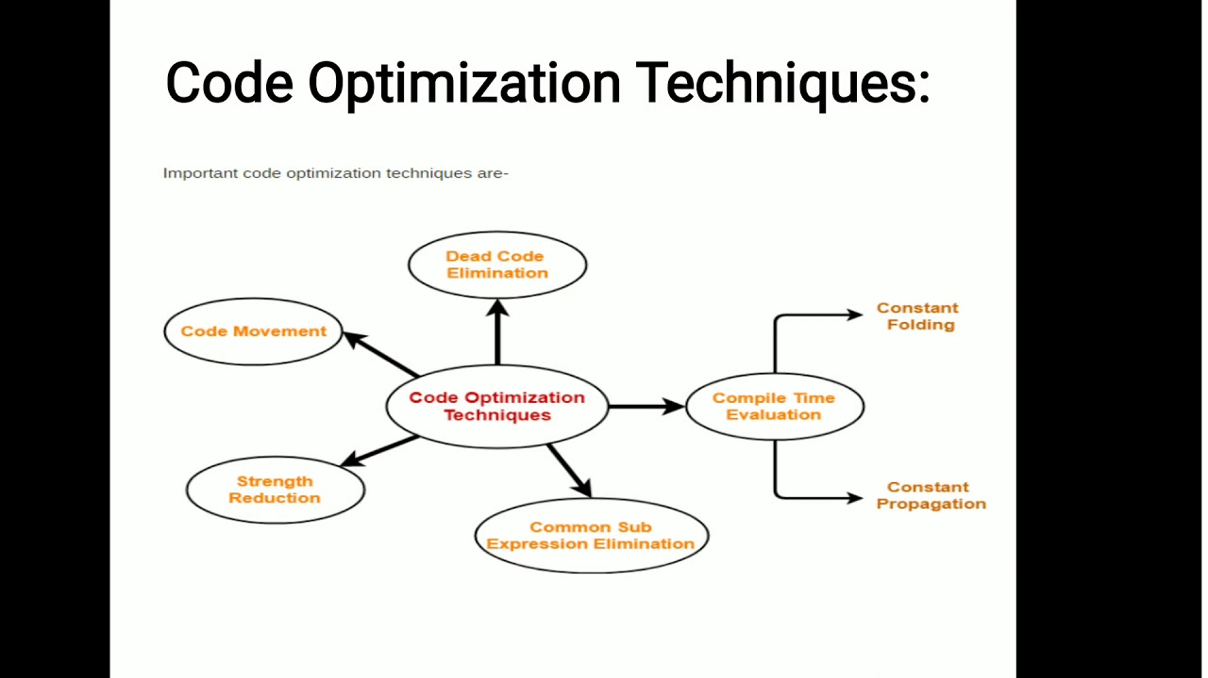
3 TYPES
LOCAL OPTIMIZATION
LOOP OPTIMIZATION
GLOBAL OPTIMIZATION
LOCAL OPTIMIZATION INCLUDES:
Constant Folding
Constant Propagation
Algebraic simplification
Operator Strength Reduction
Dead Code Elimination

Slide 9
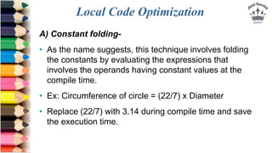
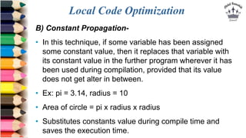
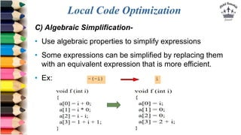
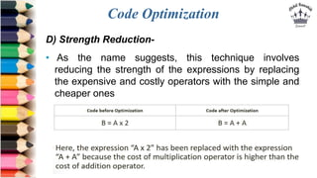
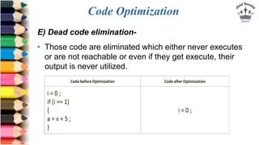
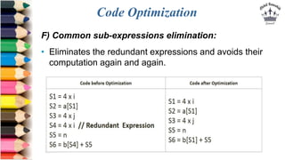
EXAMPLES WITH BASIC UNDERSTADING:

Slide 10
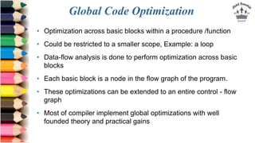
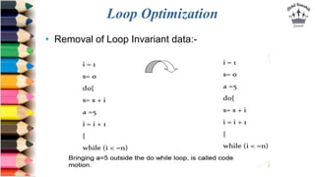

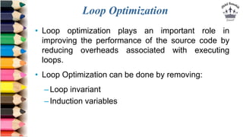
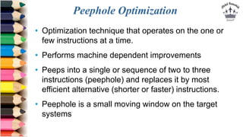
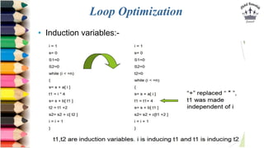
OVERALL VIEW OF THE CODE OPTIMIZITION TECHNIQUES

Slide 11

FUTURE SCOPE:
Advanced Techniques: Explore more sophisticated optimizations.
Machine Learning: Use AI to predict and apply the best optimizations.
Parallelization: Optimize for multi-core processors and GPUs.
Memory and Energy Optimization: Improve memory usage and energy efficiency.
Security: Enhance security through optimizations.
Automated Testing: Ensure correctness with automated tests.

Slide 12
This project successfully explores and implements various compiler optimization techniques to enhance the performance and efficiency of programs.
By studying methods like constant folding, dead code elimination, and loop optimization, and evaluating their impact, the project demonstrates significant improvements in code execution speed and resource usage.
The findings contribute valuable insights into the benefits and trade-offs of different optimizations, paving the way for more advanced research and development in compiler technology.
CONCLUSION

Slide 13


Slide 14

Thank you
“” The only way to do great work is to love what you do🙂””

